Slide 1
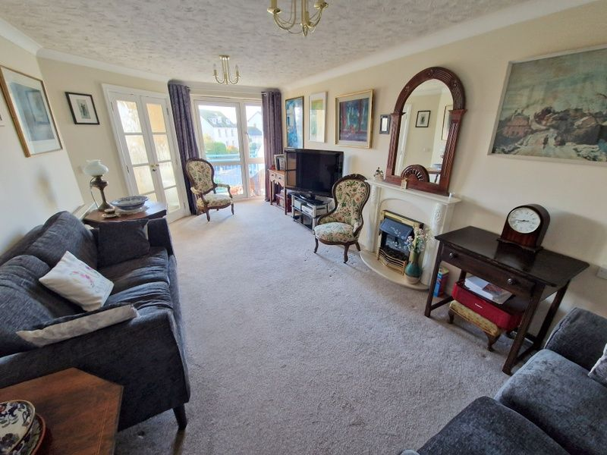
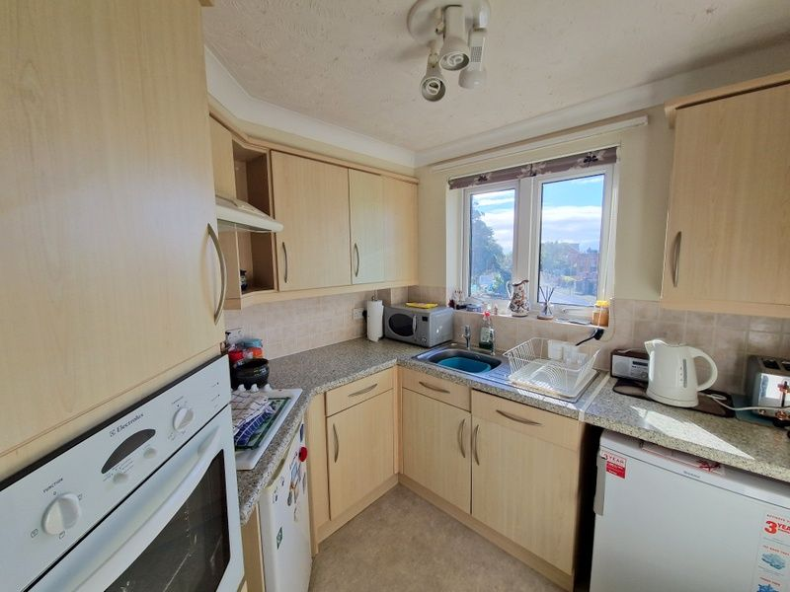
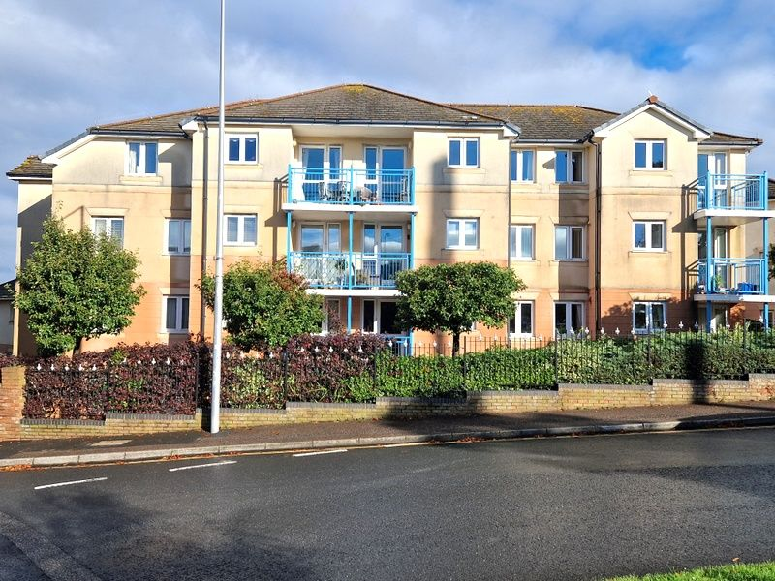
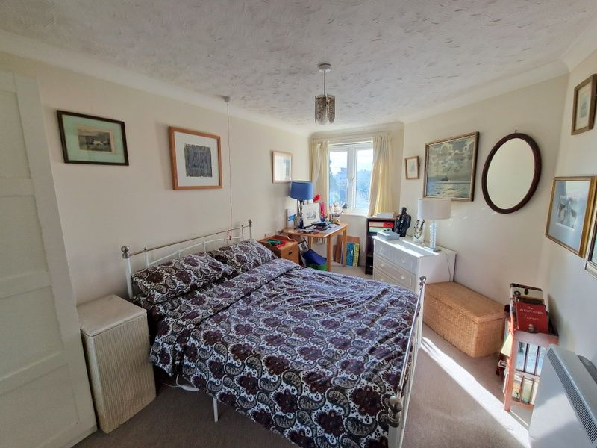
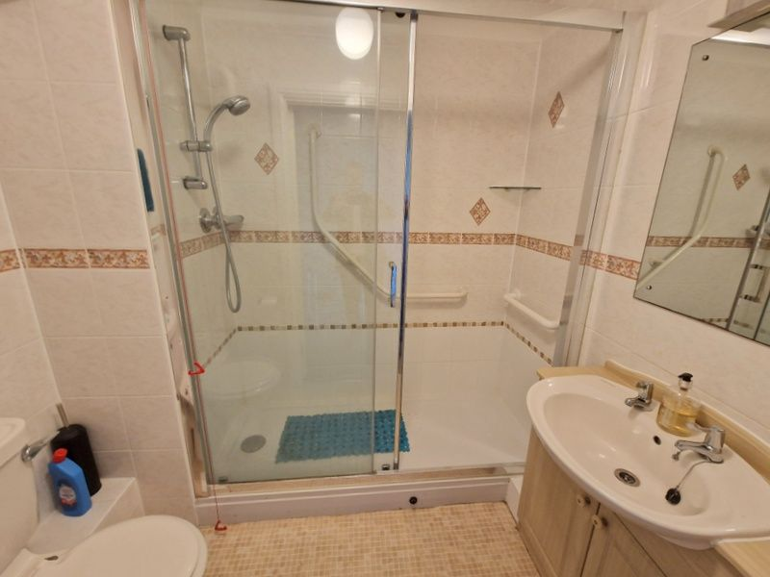
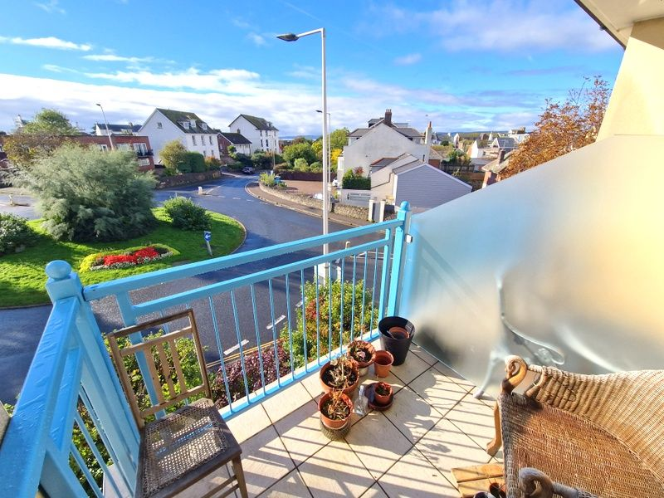
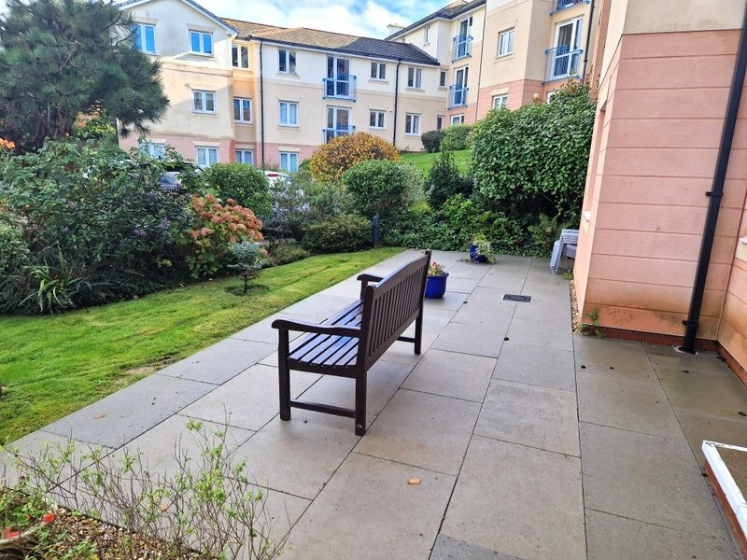
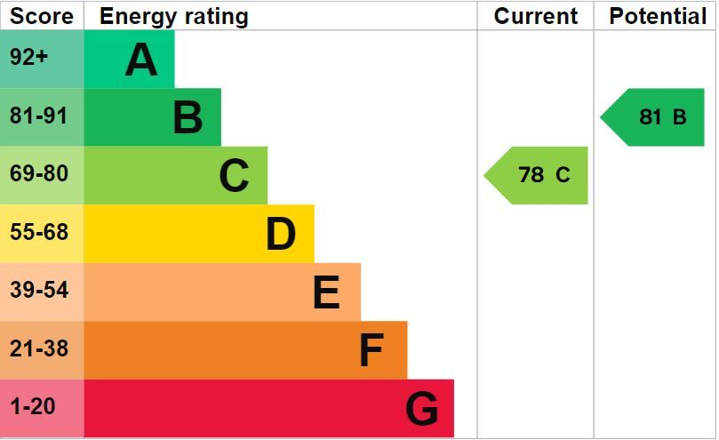
www.pennys.net
39 Admirals Court, Rolle Road, Exmouth, EX8 2BH
GUIDE PRICE £124,950
TENURE Leasehold
A Bright And Well Presented One Bedroom Top Floor Retirement Apartment Located In A Sought After Development Only A Short Distance From Exmouth Town Centre And Sea Front
Lounge/Dining Room • Fitted Kitchen • Double Bedroom With Built-In Wardrobe •
Shower Room/WC • Sun Balcony •
Double Glazed Windows • Night Storage Heating • Pleasant Open Outlook • Excellent Communal Facilities • No Onward Chain •
Pennys Estate Agents Limited for themselves and for the vendor of this property whose agents they are give notice that:- (1) These particulars do not constitute any part of an offer or a contract. (2) All statements contained in these particulars are made without responsibility on the part of Pennys Estate Agents Limited. (3) None of the statements contained in these particulars are to be relied upon as a statement or representation of fact. (4) Any intending purchaser must satisfy himself/herself by inspection or otherwise as to the correctness of each of the statements contained in these particulars. (5) The vendor does not make or give and neither do Pennys Estate Agents Limited nor any person in their employment has any authority to make or give any representation or warranty whatever in relation to this property.
PENNYS ESTATE AGENTS
2 Rolle House, Rolle Street, Exmouth, Devon, EX8 2SN
Tel: 01395 264111 EMail: help@pennys.net

Slide 2
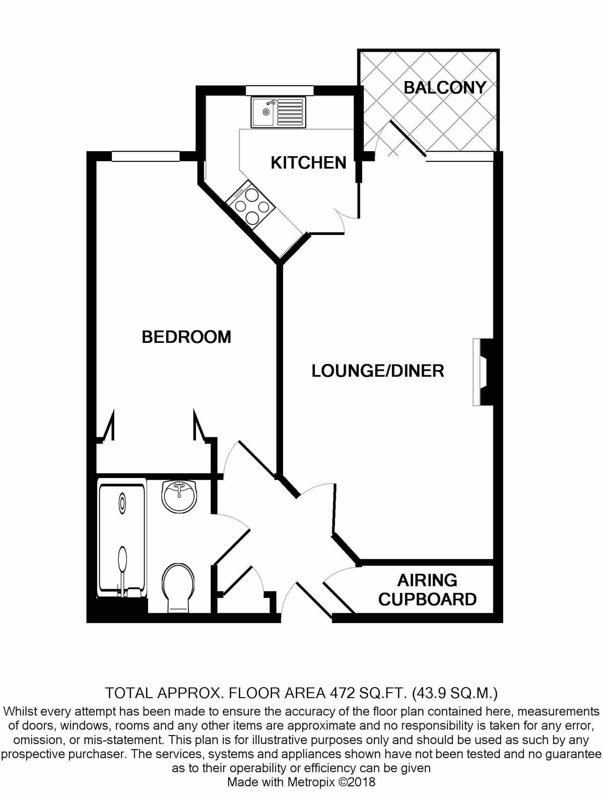
39 Admirals Court, Rolle Road, Exmouth, EX8 2BH
Admirals Court was constructed by McCarthy and Stone and is arranged over three floors, each served by a lift and stairs. There are superb communal facilities which include a residents lounge, laundry room, library, a guest bedroom suite and attractive communal gardens. The house manager can be contacted from various points within each property in case of an emergency. For periods when the house manager is off duty there is a 24 hour emergency careline response system. It is a condition of the purchase that residents be over 60 years of age and in the event of a couple, one must be over 60 and the other over 55.
THE ACCOMMODATION COMPRISES: Communal door entry system giving access to communal areas with stairs and lift to all floors. The apartment is located on SECOND FLOOR. Own private front door with spy hole giving access to:
RECEPTION HALL: With door entry intercom; access to good size storage / linen cupboard with slatted shelving, coved ceiling and light; coats cupboard housing the electric consumer unit; coved ceiling; smoke detector.
LOUNGE / DINING ROOM: 19' 10" x 10' 8" (6.05m x 3.25m) A bright and spacious room with UPVC double glazed window and UPVC double glazed door giving access to SUN BALCONY enjoying a pleasant open outlook with sea and coastline glimpses; attractive fire surround housing electric coal effect fire; night storage heater; television / FM point; telephone point; coved ceiling; emergency care line cord; double doors with patterned glass leading to:
KITCHEN: 7' 8" x 7' 6" (2.34m x 2.29m) approximate overall measurement. Fitted with a range of patterned work top surfaces; range of base cupboards, drawer units and appliance space beneath work surfaces; matching range of wall units at eye-level; inset stainless steel single drainer sink unit; inset four ring electric hob with extractor hood over; built-in oven with cupboards above and below; tiled surrounds; wall mounted electric heater; emergency care line cord; coved ceiling; UPVC double glazed window to the front aspect enjoying sea and coastline glimpses.
BEDROOM: 15' 5" x 9' 2" (4.7m x 2.79m) UPVC double glazed window to front aspect; emergency care line cord; telephone point; built-in mirror fronted wardrobes with clothes rail and shelf; coved ceiling; night storage heater; television / FM point.
SHOWER ROOM / WC: Comprising of a double width tiled shower cubicle with hand rails and shower unit; wash hand basin set in display surface with cupboards beneath, fitted mirror and light / shaver socket over; WC; fully tiled walls; electric wall heater; coved ceiling; electric heated towel rail.
OUTSIDE: Admirals court enjoys areas of communal gardens that surround the property and a communal parking area.
TENURE AND OUTGOINGS: The property is leasehold and has 103 years remaining. The service charge from 1st September 2024 is £3574.22 and the ground rent £365.00.
FLOOR PLAN:

